Slide 1
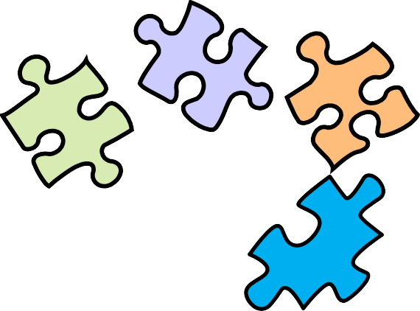

Software style and architecture

Slide 2
Software architecture
To create a reliable, secure and efficient product, you need to pay attention to architectural design which includes:
its overall organization
how the software is decomposed into components
the server organization (software-hardware mapping)
the technologies that you use to build the software. The architecture of a software product affects its performance, usability, security, reliability and maintainability.

Slide 3
The IEEE definition of software architecture
Architecture is the fundamental organization of a software system embodied in:
its components
their relationships to each other and to the environment
the principles guiding its design and evolution.

Slide 4
Software architecture and components
A component is an element that implements a coherent set of functionality or features.
Software component can be considered as a collection of one or more services that may be used by other components.
When designing software architecture, you don’t have to decide how an architectural element or component is to be implemented.
Rather, design the component interface and leave the implementation of that interface to a later stage of the development process.

Slide 5
Access to services provided by software components

Slide 6
Why is architecture important?
Architecture of a system has a fundamental influence on the non-functional system properties (explained in the next slide).
It shows the critical components of the system and their relationships.
Minimizing complexity is an important goal for architectural designers.
The more complex a system, the more difficult and expensive it is to understand and change.
Programmers are less likely to make mistakes and introduce bugs and security vulnerabilities when they are modifying or extending a complex system.

Slide 7
Non-functional system quality attributes
Responsiveness Does the system return results to users in a reasonable time?
Reliability Do the system features behave as expected by both developers and users?
Availability Can the system deliver its services when requested by users?
Security Does the system protect itself and users’ data from unauthorized attacks and intrusions?
Usability Can system users access the features that they need and use them quickly and without errors?
Maintainability Can the system be readily updated and new features added without undue costs?
Resilience Can the system continue to deliver user services in the event of partial failure or external attack?

Slide 8
Issues that influence architectural decisions

Slide 9
The importance of architectural design issues
Nonfunctional product characteristics )such as security and performance) affect all users.
If you get these wrong, your product will not be a commercial success.
However, some characteristics are conflicting: you can optimize the most important ones
Product lifetime
If you anticipate a long product lifetime, you will need to create regular product revisions.
You need an architecture that is evolvable and can accommodate new features.
Software reuse
You can save time and effort via reusing components from other open-source products.
This constrains the architectural choices: you must fit your design to the reused software.
Number of users
For the Internet-based software, the number of users can change very quickly.
This can lead to performance degradation unless the architecture can scale up & down
Software compatibility
For some products, it is important to maintain compatibility with other software.
This may limit architectural choices, such as the database software that you can use.

Slide 10
Trade off: Maintainability vs performance
System maintainability reflects how difficult and expensive it is to make changes to a system after it has been released to customers.
How to improve maintainability?
Build the system from small self-contained parts, each of which can be replaced or enhanced if changes are required.
For that, the system should be decomposed into fine-grain components, each of which does one thing only.
However, it takes time for components to communicate with each other!
Consequently, if many components are involved in implementing a product feature, the software will be slower.

Slide 11
Maintainability vs performance trade-off example
Consider a system with two modules (C1 & C2) that share a common database.
Assume C1 runs slowly because it has to reorganize the information in the database before using it.
To make C1 faster we need to change the database.
This means that C2 also has to be changed, which may, potentially, affect its response time.
Now, consider that each component has its own copy of the parts of the database that it needs.
Changing the database for C1 does not affect C2
A multi-database architecture is slower and costs more to implement.
Also a mechanism (eg, C3) needed to ensure that the data shared by C1 and C2 is kept consistent when it is changed.

Slide 12
Trade off: Security vs usability
To achieve security, we can design the system with a series of protection layers
An attacker has to penetrate all these layers before the system is compromised.
A layered approach to security affects the software usability
Users have to remember information, like passwords.
Their interaction with the system is slowed down by the security features.
Many users find this irritating and often look for work-arounds so that they do not have to re-authenticate to access system features or data.

Slide 13
Security vs Usability issues
To avoid this, you need an architecture:
that doesn’t have too many security layers,
that doesn’t enforce unnecessary security,
that provides helper components that reduce the load on users.

Slide 14
Trade off: Availability vs time-to-market
Availability of a system is the amount of ‘uptime’ of that system.
Availability is a percentage of time that a system is available to deliver services
Availability is important in enterprise products, e.g. finance industry, where 24/7 operation is expected.
Architecturally, you achieve availability by having redundant components in a system.
For redundancy, you include “failure detection”, and "switching" components that switch operation to the redundant component when a failure is detected.
Implementing extra components:
takes time and increases the cost of system development
adds complexity to the system and therefore increases the chances of introducing bugs and vulnerabilities.

Slide 15
Architectural design questions
How should the system be organized as a set of architectural components, where each component provides a subset of the overall system functionality?
The organization should deliver the system security, reliability and performance.
How should these architectural components be distributed and communicate with each other?
What technologies should you use in building the system and what components should be reused?

Slide 16
Component organization
Abstraction in software design means to focus on the essential elements of a system or software component without concern for its details.
At the architectural level, your concern should be on large-scale architectural components.
Decomposition involves analyzing these large-scale components and representing them as a set of finer-grain components.
Layered models are often used to illustrate how a system is composed of components.

Slide 17
Architectural complexity
Complexity in a system architecture arises because of the number and the nature of the relationships between components in that system.
When decomposing a system into components, try to avoid unnecessary complexity.
Localize relationships If there are relationships between components A and B, these are easier to understand if A and B are defined in the same module.
Reduce shared dependencies Where components C1 and C2 depend on some other component or data, complexity increases because changes to the shared component imply understanding how these changes affect both C1 and C2.
It is always preferable to use local data wherever possible and to avoid sharing data if you can.

Slide 18
Examples of component relationships

Slide 19
Architectural design guidelines

Slide 20
Architectural Style
We define Subsystem decomposition as:
Identification of subsystems, services, and their association to each other
Architectural Style: A pattern for a subsystem decomposition (a.k.a. design pattern)

Slide 21
Popular Architectural Styles (Development Architecture)
Layered style.
Model-View-Controller (MVC) style.
Pipe-and-Filter.
Repository style.
Hybrids of styles.

Slide 22
Layered Style Architectures
The system is partitioned into an array of layers.
A layer is a subsystem that provides a service to another subsystem with the following restrictions:
A layer only depends on services from lower layers
A layer has no knowledge of higher layers
A layer can be divided horizontally into several independent subsystems called partitions
Partitions provide services to other partitions on same layer
Partitions are also called “weakly coupled” subsystems

Slide 23
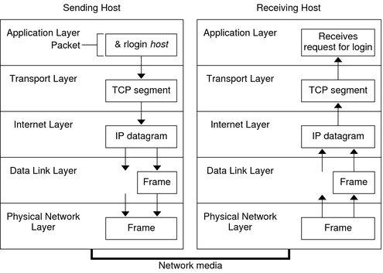
Relationships between Subsystems
Two major types of Layer relationships
Subsystem A “uses” Subsystem B if a correct version of B must be present for A to execute correctly (compile time dependency)
Subsystem A “calls” or “invokes” Subsystem B if A triggers execution of B. (runtime dependency)
Partition relationship
The subsystems have mutual knowledge about each other
A calls services in B; B calls services in A.
Best Example of layered approach: TCP/IP

Slide 24
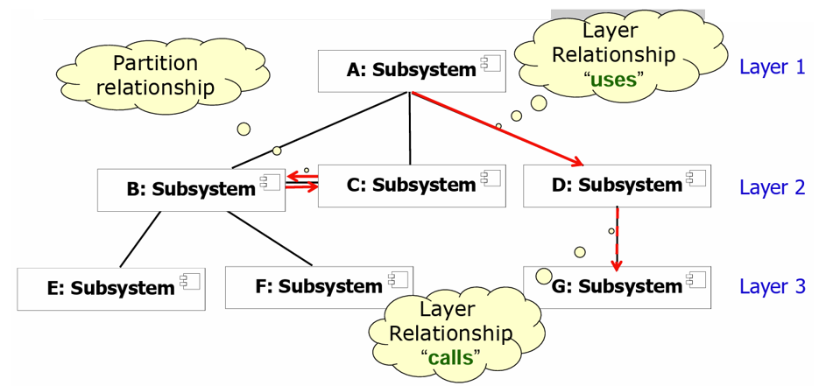
Example of a Subsystem Decomposition

Slide 25
Example of a Bad Subsystem Decomposition
UserInterface
ComponentManagement
Advertisement
Tournament
TournamentStatistics
SessionManagement
UserManagement
Why is this decomposition bad?
It has high coupling, almost every subsystem relies on every other subsystem.

Slide 26
Layer Constraints
Static structure —The software is partitioned into layers that each provide a cohesive set of services with a well- defined interface.
Dynamic structure —Each layer is allowed to use only the layer directly below it (Strict Layered style) or the all the layers below it (Relaxed Layered style).

Slide 27
Cross-cutting concerns

Slide 28
Security as a cross-cutting concern
Vulnerability at multiple layers
Attackers can try to use vulnerabilities at various layers (DB, browser, etc.) to gain access.
Protection from attacks at each layer is needed.
Having a single security component in a system is a critical vulnerability
If it stops working properly or is compromised in an attack, then you have no reliable security in your system!
By distributing security across the layers, the system is more resilient to attacks and software failure

Slide 29
A generic layered architecture for a web-based application

Slide 30
Layer functionality in a web-based application
Browser-based or mobile user interface A web browser with HTML forms are used to collect user input. Javascript components for local actions, such as input validation, should also be included at this level. Alternatively, a mobile interface may be implemented as an app.
Authentication and UI management A user interface management layer that may include components for user authentication and web page generation.
Application-specific functionality An ‘application’ layer that provides functionality of the application. Sometimes, this may be expanded into more than one layer.
Basic shared services A shared services layer, which includes components that provide services used by the application layer components.
Database and transaction management A database layer that provides services such as transaction management and recovery. If your application does not use a database then this may not be required.

Slide 31
Layered Style Advantages
Layers are highly cohesive and promote information hiding.
Layers are not strongly coupled to layers above them, reducing overall coupling.
Layers help decompose systems, reducing complexity.
Layers are easy to alter or fix by replacing entire layers, and easy to enhance by adding functionality to a layer.
Layers are usually easy to reuse.

Slide 32
Layered Style Disadvantages
Passing everything through many layers can complicate systems and damage performance.
Debugging through multiple layers can be difficult.
Getting the layers right can be difficult.

Slide 33
Architectural Styles (Development Arch.)
Layered style.
Model-View-Controller (MVC) style.
Pipe-and-Filter.
Repository style.
Hybrids of styles.

Slide 34
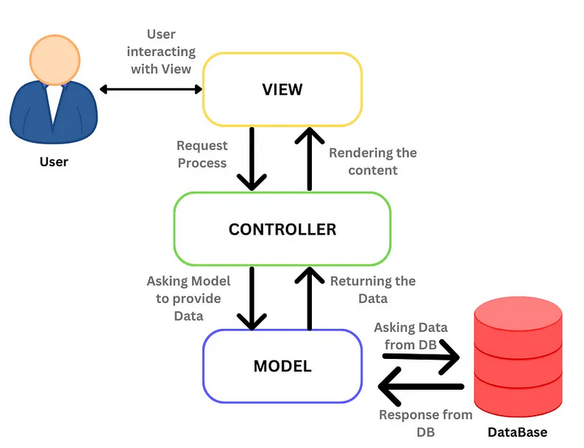
Model-View-Controller (MVC) Style
This style models considers 3 subsystems for the software:
Model subsystem: Responsible for representing the domain-specific information on which the application operates.
View subsystem: Responsible for displaying the model into a form suitable for interaction, typically, a user interface element.
Controller subsystem: Processes and responds to events, typically, user actions, and may invoke changes on the model and view.

Slide 35
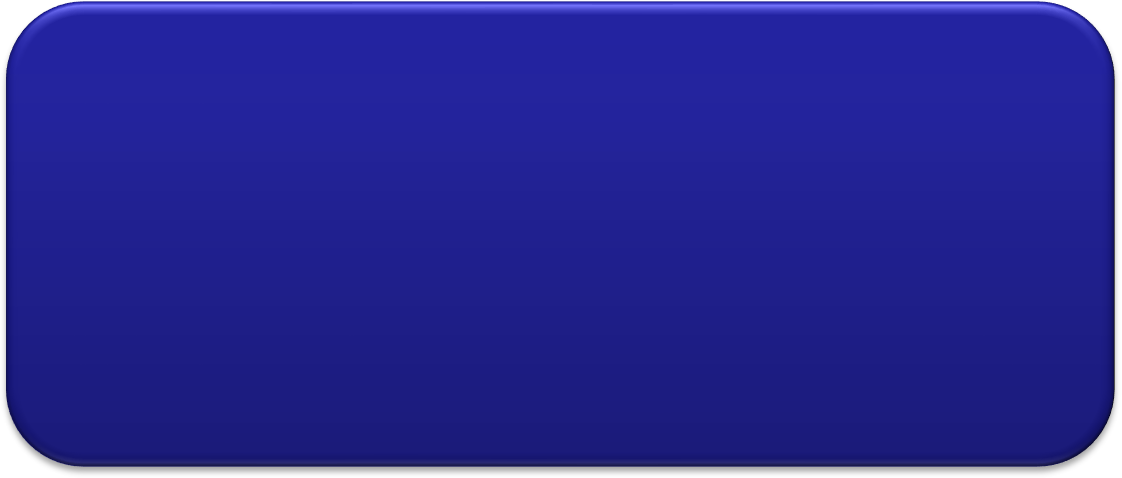
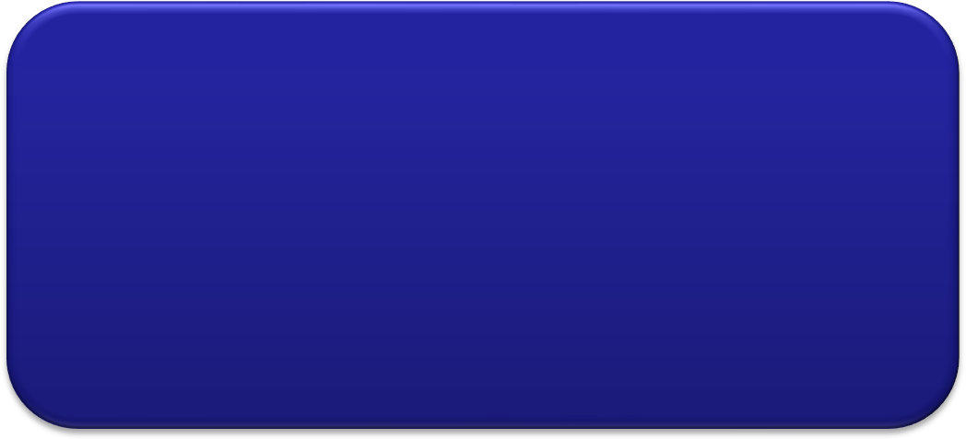
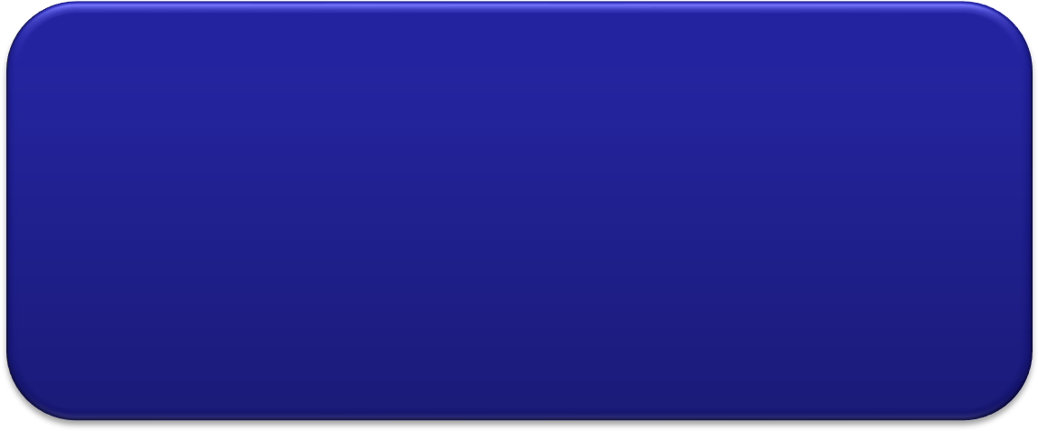
Architecture Diagram
Events Method calls
Model
Encapsulates application state
Responds to state queries
Exposes application functionality
Notifies views of changes
Update notification
Get State
Set State
View
Renders the models
Request updates from models
Sends user actions to controller
Allows controller to select view
Change View
Controller
Defines application behavior
Maps user actions to model updates
Selects view for response
User Actions

Slide 36

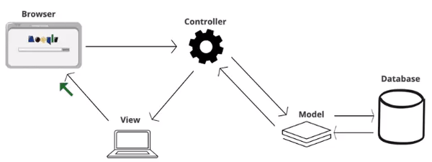
The model-view-controller architectural pattern
MVC is all about separation of concerns:
Model
View
Controller

Slide 37
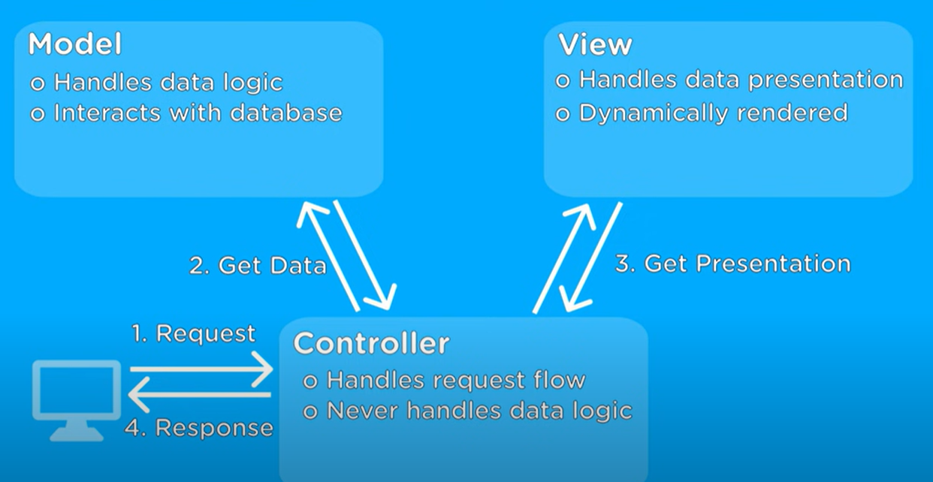
MVC: a popular architecture for web applications

Slide 38
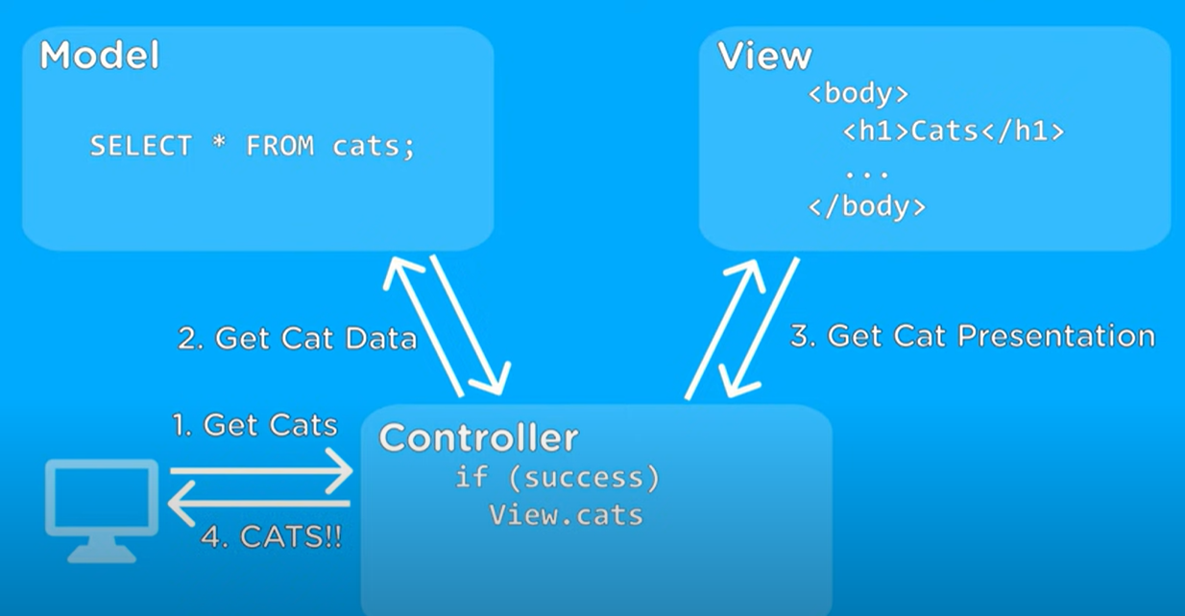
MVC: example for retrieving cats' information
Get error presentation
else
View.error

Slide 39
MVC Advantages
MVC style decouples data access and data presentation
The Data Presentation subsystem is called the View
The Data Access subsystem is called the Model
The Controller subsystem mediates between View (data presentation) and Model (data access)
Views and controllers can be added, removed, or changed without disturbing the model.
User interface components can be changed, even at runtime.

Slide 40
MVC Disadvantages
Views and controller are often hard to separate.
Frequent updates may slow data display and degrade user interface performance.
The MVC style makes user interface components highly dependent on model components.

Slide 41
Architectural Styles (Development Architecture)
Layered style.
Model-View-Controller (MVC) style.
Pipe-and-Filter.
Repository style.
Hybrids of styles.

Slide 42
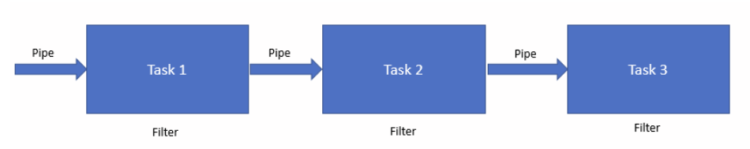
Pipe-and-Filter Style
A filter is a software component that transforms an input stream to an output stream.
A pipe is conduit for a stream.
The Pipe-and-Filter style is a dynamic model in which software components are filters connected by pipes.

Slide 43




Pipe-and-Filter – Example
Programming language compiler design
Lexical Analyzer
A Filter
A Pipe
Parser
Semantic Analyzer
Code Generator

Slide 44
Pipe-and-Filter – Example (2)
Example of a Pipes-and-Filters architecture: Unix
Unix shell command: ls -a l cat
A pipe
The Unix shell commands ls and cat are Filter

Slide 45
Pipe-and-Filter Characteristics
Pipes are isolated and usually only communicate through data streams, so, they are easy to write, test, reuse, and replace.
Filters may execute concurrently.
Requires pipes to synchronize filters
Pipe-and-filter topologies should be acyclic graphs.

Slide 46
Pipe-and-Filter Advantages
Filters can be modified and replaced easily.
Filters can be rearranged with little effort, making it easy to develop similar programs.
Filters are highly reusable.
Ideal for “stream processing” software systems

Slide 47
Pipe-and-Filter Disadvantages
Filters communicate only through pipes, which makes it difficult to coordinate them.
Filters usually work on simple data streams, which may result in wasted data conversion effort.
Error handling is difficult.

Slide 48
Architectural Styles (Development Architecture)
Layered style.
Model-View-Controller (MVC) style.
Pipe-and-Filter.
Repository style.
Hybrid styles.

Slide 49
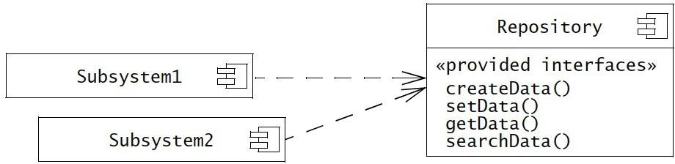
Repository Architectural Style
Subsystems access and modify data from a single data structure called the repository
Subsystems are loosely coupled (interact only through the repository)

Slide 50
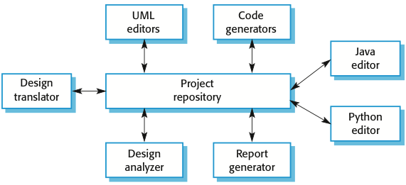
Repository Architecture Example

Slide 51
Repository Style Advantages
Subsystems communicate only through the Repository, so, they are easy to change, replace, remove, or add to.
Subsystems independence increases robustness and fault tolerance.
Placing all data in the Repository store makes it easier to secure and control.

Slide 52
Repository Style Disadvantages
Forcing all data through the Repository store may degrade performance.
If the Repository store fails, the entire program is down.

Slide 53
Architectural Styles (Development Architecture)
Layered style.
Model-View-Controller (MVC) style.
Pipe-and-Filter.
Repository style.
Hybrids of styles.

Slide 54
Hybrid Architectures
Most systems of any size include several architectural styles, often at different levels of abstraction.
An overall a system may have a Layered style, but the one layer may use the Pipe-and-Filter style, and another the Repository style.
An overall system may have a Pipe-and-Filter style, but the individual filters may have Layered styles.

Slide 55
Deployment Architecture (Hardware/Software Mapping)

Slide 56
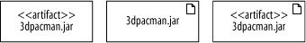
Deployed Software: Artifacts
Artifacts are physical files that execute or are used by your software
Common artifacts include:
Executable files, such as .exe or .jar files
Library files, such as .dlls
Source files, such as .java, .cs or .cpp files
Configuration files that are used by your software at runtime, commonly in formats such as .xml, or .txt
An artifact is shown as a rectangle with the stereotype <<artifact>>
as follows:

Slide 57
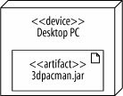
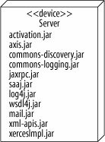
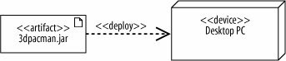
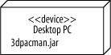
Deploying an Artifact to a Node
An artifact is deployed to a node, which means that the artifact resides on (or is installed on) the node.
In UML, we draw it as:
or
or in compact way as:

Slide 58
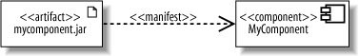
Tying Software to Artifacts
When we design software, we break it up into groups of functionality, such as components or packages which eventually get compiled into one or more files or artifacts.
In UML-speak, if an artifact is the physical actualization of a component, then the artifact represents that component.
An artifact can manifest not just components but any packageable element, such as packages and classes.
The stereotype <<manifest>> is used to show the manifest relationship as shown

Slide 59
What is a Node?
We used a node to show hardware, but nodes don't have to be always hardware.
Certain types of software that provides an environment within other software components are nodes as well.
A node is a hardware or software resource that can host software or related files.
Examples of hardware nodes:
Server
Desktop PC
Disk drives
Examples of execution environment nodes:
Operating system
Container
Web server
Application server
VM

Slide 60
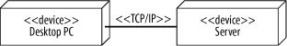
Communication Between Nodes
To get its job done, a node may need to communicate with other nodes.
For example, a client application running on a desktop PC may retrieve data from a server using TCP/IP.
The type of communication is shown by adding a stereotype to the path.

Slide 61
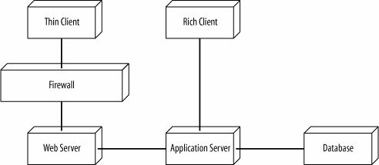
Deployment Diagram
When we begin designing a system, we probably know only basic information about the physical layout.
For example, if we are building a web application, we may not have decided which hardware to use and probably don't know what our software artifacts are called. But we want to communicate important characteristics of our system, such as the following:
The architecture includes a web server, application server, & DB.
Clients can access the application through a browser or through a richer GUI interface.
The web server is protected with a firewall.
Even at this early stage we can use deployment diagrams to model these characteristics.

Slide 62
Examples of Systems Architectural (Deployment Model)
Client/Server
Two-tier, Multi-tier Architecture
Peer-To-Peer

Slide 63
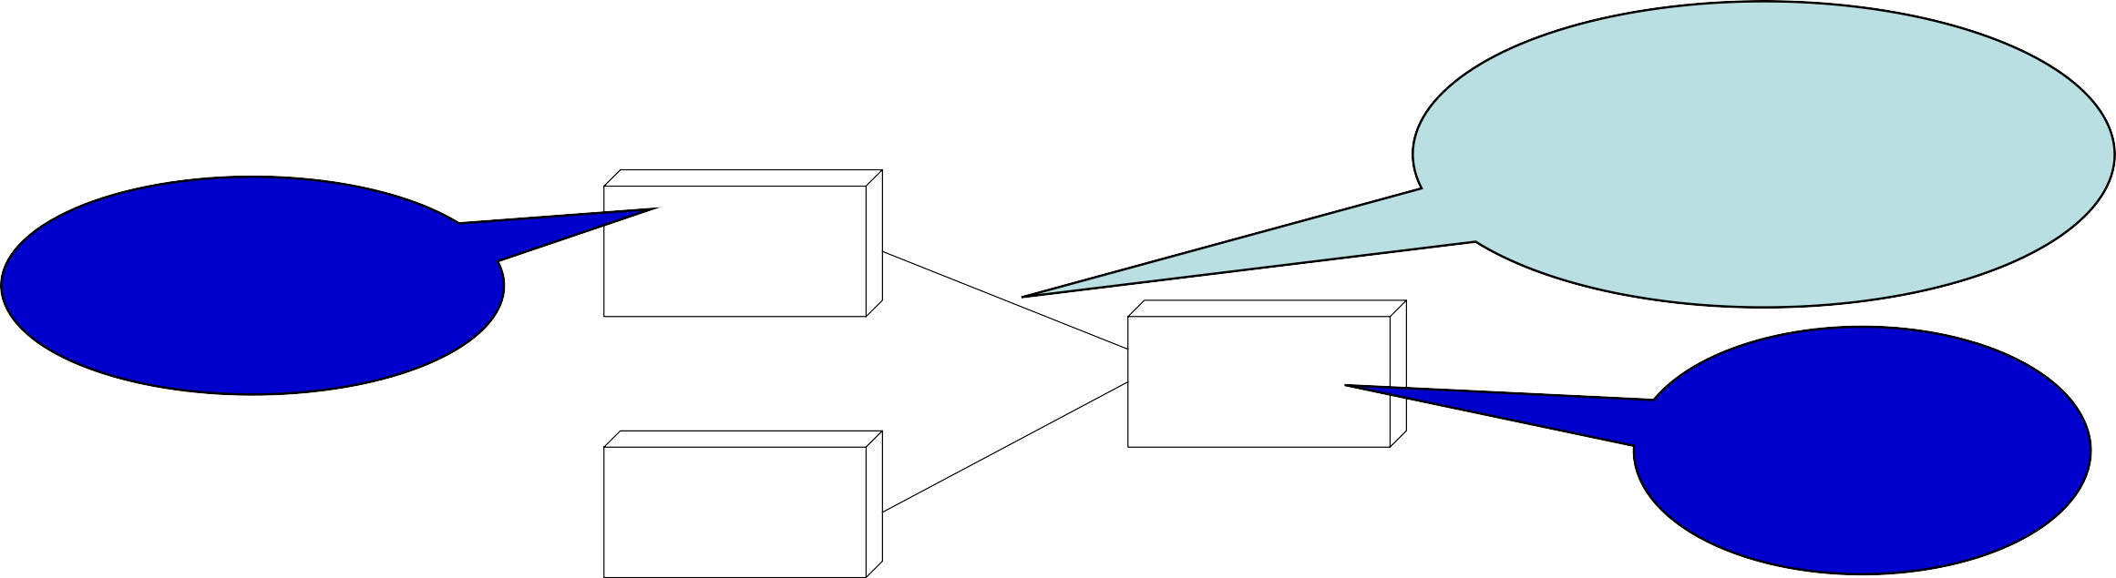
Client-server communication
Client-server communication normally uses the HTTP protocol.
The client sends a message to the server that includes an instruction such as GET or POST along with the identifier of a resource (usually a URL) on which that instruction should operate. The message may also include additional information, such as information collected from a form.
HTTP is a text-only protocol so structured data has to be represented as text. There are two ways of representing this data that are widely used, namely XML and JSON.
XML is a markup language with tags used to identify each data item.
JSON is a simpler representation based on the representation of objects in the Javascript language.
Connectivity
e.g., TCP/IP, HTTP, JDBC
Requester
e.g., Web Browser, Windows app
Client1
Server
Provider
e.g., Web Server, DB server
Client2

Slide 64
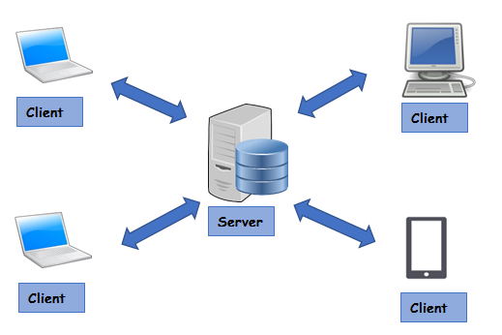
Client/Server Architectures
Often used in the design of database systems
Front-end: User application (client)
Back-end: Database access and manipulation (server)
Functions performed by client:
Input from the user (Customized user interface)
Front-end processing of input data
Functions performed by the database server:
Centralized data management
Data integrity and database consistency
Database security

Slide 65
Two-tier client server architectures
Note: Layer and Tier are often used interchangeably.
In a two-tier client-server architecture, the system is implemented as a single logical server plus an indefinite number of clients that use that server.
Thin-client model, where the presentation layer is implemented on the client and all other layers (data management, application processing and database) are implemented on a server.
Fat-client model (or Rich-client), where some or all of the application processing is carried out on the client. Data management and database functions are implemented on the server.

Slide 66





Thin- and fat-client architectural models
Presentation only
<<device>> Server
<<device>> Thin Client
<<executionEnvironment>> Application Logic
Thin Client Model
<<executionEnvironment>> Web Browser
<<execution Environment>> Web Server
<<execution Environment>> DB Server
Presentation
& Application Processing
<<device>> Fat Client
<<device>> Server
<<executionEnvironment>> GUI Client
<<executionEnvironment>> Web Server
Fat Client Model
<<executionEnvironment>> Client Application Logic
<<executionEnvironment>> DB Server

Slide 67
Distribution architecture
The distribution architecture of a software system defines the servers in the system and the allocation of components to these servers.
Client-server architectures are a type of distribution architecture that is suited to applications where clients access a shared database and business logic operations on that data.
In this architecture, the user interface is implemented on the user’s own computer or mobile device.
Functionality is distributed between the client and one or more server computers.

Slide 68
Client-server architecture

Slide 69
Multi-tier client-server architectures
In a ‘multi-tier client–server’ architecture, the different layers of the system, namely presentation, data management, application processing, and database, are separate processes that may execute on different processors.
This avoids problems with scalability and performance if a thin-client two-tier model is chosen, or problems of system management if a fat-client model is used.

Slide 70
3-tier architecture for an Internet banking system
Tier 1 - Presentation
Tier 2 -Application processing and data management
<<device>> Thin Client
Tier 3 -Database processing
HTTP
<<device>> Sun Server
<<device>> Sun Server
<<device>> Thin Client
<<executionEnvironment>> Web Server
SQL query
<<executionEnvironment>> DB Server
<<device>> Thin Client
Account Service provision
Customer account database
<<device>> Thin Client

Slide 71
MVC (Development Arch. vs. 3-Tier (Deployment Arch.)
The MVC architectural style is nonhierarchical (triangular):
View subsystem sends updates to the Controller subsystem
Controller subsystem updates the Model subsystem
View subsystem is updated directly from the Model subsystem
The 3-tier architectural style is hierarchical (linear):
The presentation layer never communicates directly with the data layer
All communication must pass through the middleware layer

Slide 72
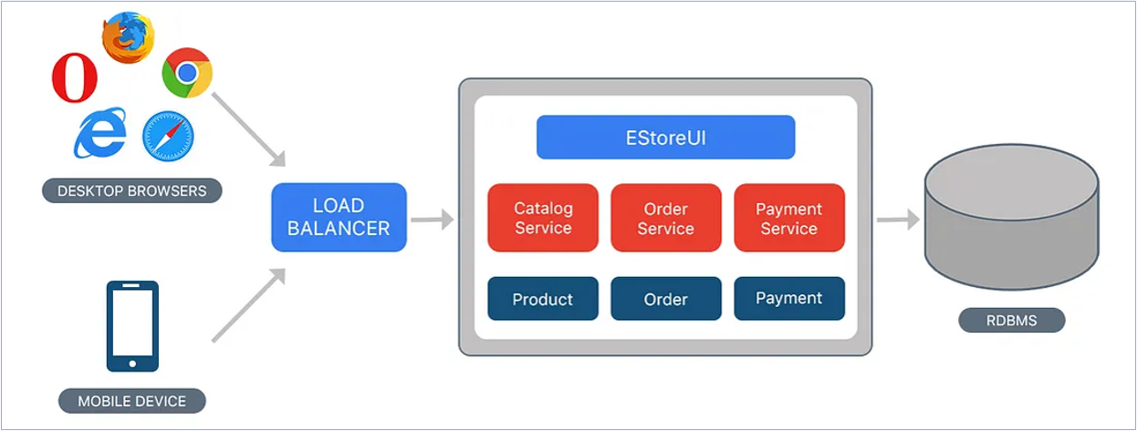
Monolithic Architecture
The entire application is in one piece (process)
A Monolithic application can be developed using MVC, Layered, etc. as their “Development Arch.”

Slide 73

Monolithic MVC
www.amazon.com
IP <172.108.198.157>
Virtual Network <->
DNS
Virtual Machine (VM-1)
Single Docker Image
Load Balancer
Complete Project
DB’s
View
Controller
Model
VM-2
VM-3
VM-n
HTML, CSS & JavaScript
Service logic & data manipulations using HTTP actions
ORM
Advantages: - Simple design and easy monitoring.
- Low network latency and easy deployment.
Dis-advantages: - More resource utilization and Low scalability.
- Difficult to upgrade or revert the code and technologies.

Slide 74
Service-oriented architecture (SOA)
Services in SOA are stateless components
that they can be replicated and can migrate from one computer to another.
Many servers may be involved in providing services
A service-oriented architecture is usually easier to scale as demand increases and is resilient to failure.

Slide 75
Service-oriented architecture (SOA)

Slide 76

Service Oriented Architecture (SOA)
Let’s take Web-based MS Word as an example:
Pod=container
Virtual network
End Users
Kubernetes Cluster
Load Balancer
Pod 1
Pod n
Network Traffic
Node 1
Edit Service (MVC)
Edit Service (MVC)
Pod 1
Pod n
Node 2
Print Service (MVC)
Print Service (MVC)
Route Requests
Pod 1
Pod n
Node 3
Comment Service (MVC)
Comment Service (MVC)
Pod 1
Pod n
Node k
Formatting Serv. (MVC)
Formatting Serv. (MVC)
External Load Balancer: It routes user requests to appropriate pods in Kubernetes.
Internal K8s Load Balancer: It’s used for scalability of a specific service based on user requests.

Slide 77
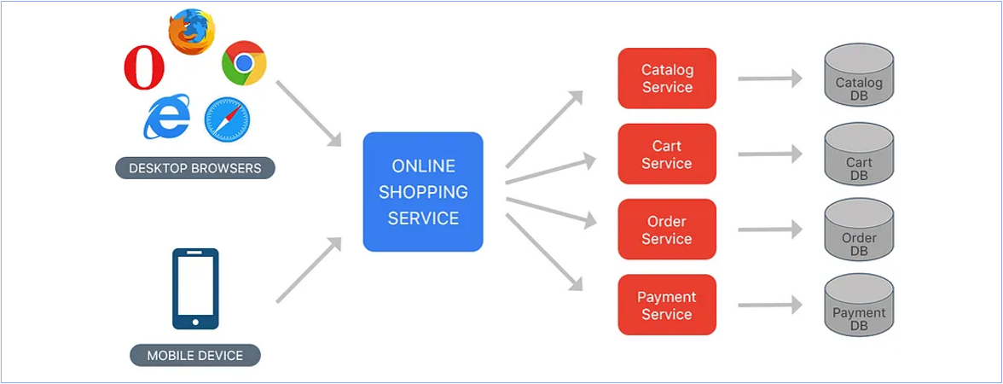
Microservice Architecture

Slide 78
Microservice Architecture: A deeper Perspective
Let’s take web-based MS Word as an example:
Network of computers
Kubernetes Cluster
Pod 1
Pod n
Node 1
Pod 1
Pod n
Node 1
Pod 1
Pod n
Node 1
Edit Service (Model)
Edit Service (Model)
Edit Service (Controller)
Edit Service (Controller)
Edit Service (View)
Edit Service (View)
Pod 1
Pod n
Node 2
Pod 1
Pod n
Node 2
Pod 1
Pod n
Node 2
Print Service (Model)
Print Service (Model)
Print Service (Controller)
Print Service (Controller)
Print Service (View)
Print Service (View)
Pod 1
Pod n
Node 3
Pod 1
Pod n
Node 3
Pod 1
Pod n
Node 3
Format Service (Model)
Format Service (Model)
Format Service (Controller)
Format Service (Controller)
Format Service (View)
Format Service (View)
Pod 1
Pod n
Node k
Pod 1
Pod n
Node k
Pod 1
Pod n
Node k
Comment Service (Model)
Comment Service (Model)
Comment Service (Controller)
Comment Service (Controller)
Comment Service (View)
Comment Service (View)

Slide 79
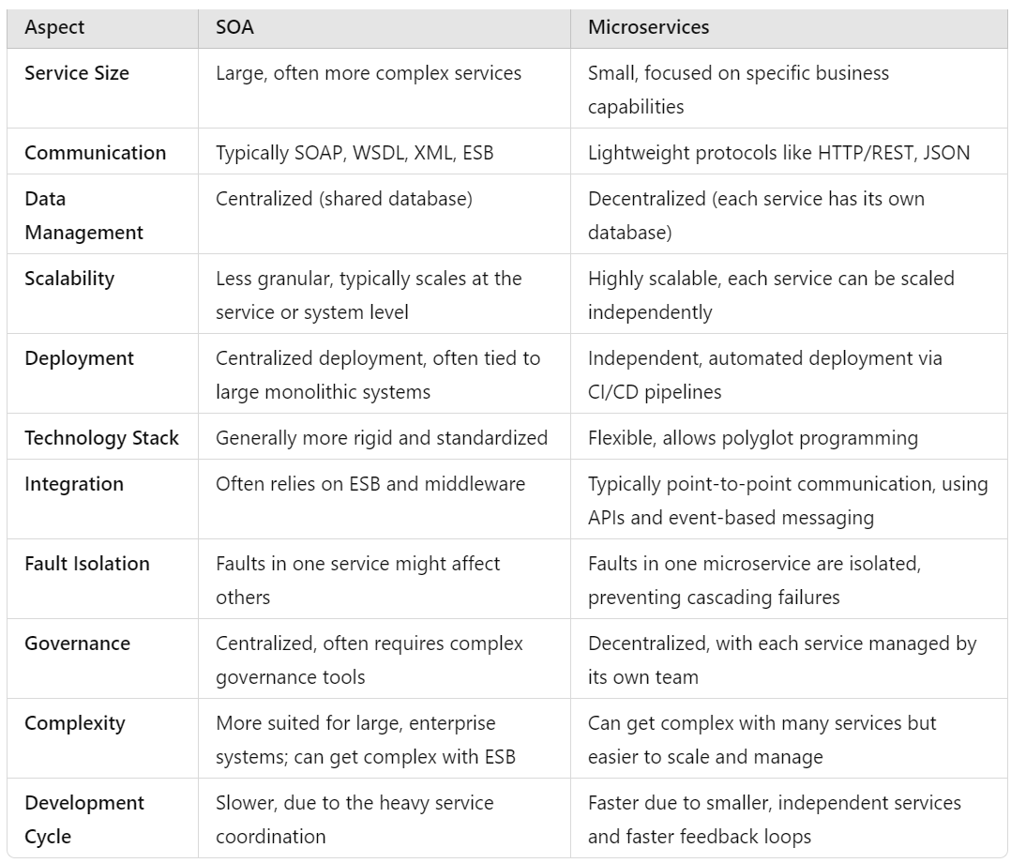
* ESB= Enterprise Service bus; all the communications between services happen through ESB, it also acts like a service registry. In Micro-services we have service registry (e.g., Zookeeper and etcd) that act like a database of active services and for service discovery and routing

Slide 80
Problems of microservices design (from a paper by Google):
C1: hurts performance. The overhead of serializing data and sending it across the network is increasingly becoming a bottleneck. When developers over-split their applications, these overheads compound.
C2: hurts correctness. It is extremely challenging to reason about the interactions between every deployed version of every microservice. In a case study of over 100 catastrophic failures of eight widely used systems, two-thirds of failures were caused by the interactions between multiple versions of a system.
C3: hard to manage. Rather than having a single binary to build, test, and deploy, developers have to manage 𝑛 different binaries, each on their own release schedule. Running end-to-end tests with a local instance of the application becomes an engineering problem.
C4: freezes APIs. Once a microservice establishes an API, it becomes hard to change without breaking the other services that consume the API. Legacy APIs linger around, and new APIs are patched on top.
C5: slows down application development. When making changes that affect multiple microservices, developers cannot implement and deploy the changes atomically. They have to carefully plan how to introduce the change across 𝑛 microservices with their own release schedules
Towards Modern Development of Cloud Applications (acm.org)

Slide 81
SOA and Micro-Services (M-S) vs MVC
Purpose:
SOA and M-S break applications into small, loosely coupled services that developed, deployed independently
MVC is a design pattern used for organizing the components/logic of an application, especially for web apps.
Granularity:
SOA and M-S are typically fine-grained, with each service focused on a specific function or feature.
MVC doesn't prescribe a specific granularity for components. It can be at the application level or module level
Independence:
SOA & M-S are developed, deployed, and scaled independently (with its own technology stack, database).
MVC separates concerns within one application but doesn't enforce independence between components.
Scalability:
SOA & M-S is scalable as individual services can be scaled independently based on demand.
MVC doesn't inherently consider scalability at the architectural level (it is not about scalability, basically)
Technology Stack:
Each M-S can use its own technology stack and database based on the requirements of that service.
MVC is a design pattern that can be applied within various technology stacks, including Java, .NET, etc.
Use Cases:
M-S is for large and distributed applications (Ex. e-commerce, social media) with multiple independent modules
MVC is often used for structuring applications where separation of concerns is needed.

Slide 82
Issues in architectural choice
Data type and data updates
For structured data, the best practice is to have a single shared database that provides locking and transaction management.
For distributed data across services, you need a way to keep it consistent
this adds overhead to your system.
Change frequency
If some system components will be regularly updated, then isolating these components as separate services simplifies those changes.
The system execution platform
For cloud-based applications, use SOA/M-S
Scaling the application is simpler
This is known as “distributed software architecture”!
For business apps running on local servers, a multi-tier architecture is suitable

Slide 83
Technology choices
Database Should you use a relational SQL database or an unstructured NOSQL database?
Platform Should you deliver your product on a mobile app and/or a web platform?
Server Should you use dedicated in-house servers or public cloud? (AWS, Azure)?
Open source Are there suitable open-source components that you could incorporate into your products?

Slide 84
Database
There are two kinds of database that are commonly used:
Relational databases, where the data is organized into structured tables
NoSQL databases, in which the data has a more flexible without transaction!
Vector databases: for similarity across objects (texts, images, etc.)
Relational databases (e.g., MySQL) are suitable for situations where you need transaction support, and the data structures are known and simple.
NoSQL databases, such as MongoDB, are more flexible and potentially more efficient than relational databases for data analysis.
NoSQL databases allow data to be organized hierarchically rather than as flat tables and this allows for more efficient concurrent processing of ‘big data’.

Slide 85
Delivery platform: Web? Mobile? Both?
Mobile issues:
Intermittent connectivity You must be able to provide a limited service without network connectivity.
Processor power Mobile devices have less powerful processors, so you need to minimize computationally-intensive operations.
Power management Mobile battery life is limited so you should try to minimize the power used by your application.
On-screen keyboard On-screen keyboards are slow and error-prone. You should minimize input using the screen keyboard to reduce user frustration.
To deal with these differences, you usually need separate browser-based and mobile versions of your product front-end.
You may need a different architecture in these different versions to ensure that performance and other characteristics are maintained.

Slide 86
Server: Local vs Cloud?
A key decision is whether to design your system to run on customer servers or to run on the cloud.
Some businesses are concerned about cloud security and prefer to run their systems on in-house servers.
Sometimes they have a predictable usage pattern (workload), so there is less need to design the system to cope with demand changes
Another important question is which cloud provider to use?!

Slide 87
Open-Source
Open-source software is software that is available freely, which you can change and modify as you wish.
Advantage: you can reuse rather than implement new software, which reduces development costs and time to market.
Disadvantage: you are constrained by that software and have no control over its evolution.
The decision on the use of open-source software also depends on the availability, maturity and continuing support of open-source components.
Open-source license issues may impose constraints on how you use the software.

Slide 88
Development tools
Development technologies, such as a mobile development toolkit or a web application framework, influence the architecture of your software.
These technologies have built-in assumptions about system architectures and you have to conform to these assumptions to use the development system.
The development technology that you use may also have an indirect influence on the system architecture.
Developers usually favor architectural choices that use familiar technologies that they understand.
For example, if your team have a lot of experience of relational databases, they may argue for this instead of a NoSQL database.

Slide 89
Key points 1
Software architecture is the fundamental organization of a system embodied in its components, their relationships to each other, and to the environment, and the principles guiding its design and evolution.
The architecture of a software system has a significant influence on non-functional system properties such as reliability, efficiency and security.
Architectural design involves understanding the issues that are critical for your product and creating system descriptions that shows components and their relationships.
The principal role of architectural descriptions is to provide a basis for the development team to discuss the system organization. Informal architectural diagrams are effective in architectural description because they are fast and easy to draw and share.
System decomposition involves analyzing architectural components and representing them as a set of finer-grain components.

Slide 90
Key points 2
To minimize complexity, you should separate concerns, avoid functional duplication and focus on component interfaces.
Web-based systems often have a common layered structure including user interface layers, application-specific layers and a database layer.
The distribution architecture in a system defines the organization of the servers in that system and the allocation of components to these servers.
Multi-tier client-server and service-oriented architectures are the most commonly used architectures for web-based systems.
Making decisions on technologies such as database and cloud technologies are an important part of the architectural design process.

Slide 91
1. Smart Home Automation System
User Scenario: Imagine a homeowner who wants to enhance the convenience, security, and energy efficiency of their home. They desire to control and monitor various smart devices such as thermostats, lights, security cameras, and door locks through a centralized system.
Use Case Scenarios:
Morning Automation: The system adjusts the thermostat, opens smart blinds, and turns on lights based on the time of day when the homeowner wakes up.
Away Mode: When the homeowner leaves, the system ensures all lights are turned off, the thermostat is set to an energy-efficient mode, and security cameras are activated.
Energy Optimization: The system analyzes energy consumption patterns and suggests optimizations, such as adjusting thermostat settings or recommending energy-efficient lighting schedules.
Security Alerts: The system sends alerts to the homeowner's mobile app in case of unusual activity, such as unexpected door openings or motion detected when the house is supposed to be empty.

Slide 92
Architectural Design: Pattern
We choose “Layered” approach because …
User Interface Layer
Application Layer
Business Logic Layer
Middleware Layer
Data Access Layer
User
Device Controls
Automation Policy Engine
Centralized Controller ( Action triggers, Pairing, Policy Executor)
Device Driver Modules
Repositories
Automation Configurations
Scheduler
Module
Wi-Fi
Automation Models
Smart Devices like thermostats, lights, security cameras and door locks
Device Security Module
Database
Energy Optimization Module (AI-based)
Bluetooth
Data Monitoring Models
Alerts and Notifications
Event Handlers Module
Authenticator Module
HTTP Actions
Scheduler Models
Authentication Display
(Digital key, Biometric)
Facial or voice Authentication (AI)
Parallel Device Control & Orchestration
Cloud API Integrations
User Authentication Models

Slide 93
Layered Architecture Explanation for Smart Home Automation System:
Presentation Layer: It is an user interface layer which will provides access to end user to provide instructions to our smart home automation system using mobile or computer. It performs operations like
Device Controls: Provides interface for user or home owner to control and interacts with smart devices.
Automation Configurations: Enables users to set up and manage automation scenarios.
Alerts and Notifications: Displays real-time alerts and notifications for security events or system updates.
Authentication Display: Enables user to authenticate with their secure digital key or using face detection or finger print identification to get access to our system.
Application Layer: This authenticates user and automate the system based on user input from presentation layer.
Automation Rules Engine: It allows users to define automation rules based on conditions and triggers. For example, If a motion is detected, then that areas light will turns on and thermostat’s temperature is adjusted.
Scheduler Module: It enables user to schedule ON/OFF actions at specific time in day wise or weekly bases.
Energy Optimization Module: It analyzes previously usage history and provide energy optimization suggestions.
Authentication Module: It authenticates the user based on user selected authentication type.
Artificial Intelligent module: It provides all kind of predictions for energy optimizations and authentications.
Business Logic Layer: This layer helps to provide all kind of secure logics and parallel processing's in our application.
Centralized Controller: Processes user commands from UI and user actions then triggers actions in an appropriate smart devices. It manages complete lifecycle of devices including device pairings, device removal and all other rule executions.
Device Security Module: Enable security actions like activating or deactivating security cameras based on events and sending alerts back to user.
Event Handlers: Responding to the security events generated by cameras or other smart device sensors and log it in a database for future predictions.
Parallel Processing and Orchestration: Executes multiple commands from user in a single instant time and generate automated instructions to specific device.

Slide 94
Layered Architecture Explanation for Smart Home Automation System : (Continued...)
4. Integration Layer: It will integrate and co-ordinates our application with mobile or computer with smart devices. It also provide could service integrations to upscale the usage and performance.
Device Driver Module: Provides device drivers and adaptors to translate commands between the centralized controller.
Wi-Fi and Bluetooth: Provides device communications with Wi-Fi and Bluetooth protocols.
HTTP Actions: Enables Application Programming Interface (API) calls between different services and databases by using HTTP/HTTPS protocol.
Cloud API Integrations: Manages communication with the cloud, including user authentication, data synchronization, and remote access.
5. Data Access Layer: Its responsible for managing the storage and retrieval of data from various sources like authentication, user preferences, schedule info, automation rules, history of previous iterations for future predictions.
Repositories: To perform the data operations like create, read, update and delete.
Automation Models: To handle the automation rules and other details by interacting with database.
Data Monitoring Models: To handle system logs, alerts and notification details in database to maintain history.
Scheduler Models: Used to handle scheduled information in database for energy optimization.
User Authentication Models: To handle registration, login and forget password operations from database.
6. Database: To store all user specific, application specific and automation information.

Slide 95
Architectural Design: Style
It is going to be deployed on a home (a.k.a. edge) server, therefore, we choose Monolith software architecture
It is easier to develop and faster
There is no need for scalability across multiple users, so Micro-services or SOA are redundant (overkill)
Discussion:
If it was a cloud-based solution managing across multiple users, then scalability for at the service level was becoming a challenge and Micro-service-based arch. was preferred.

Slide 96
Justification for Layered Architecture in Smart Home Automation System:
Modularity: Each layer has a specific responsibility, making the system modular and easy to understand and modify. New devices or features can be added without affecting the entire system.
Scalability: Individual layers can be scaled independently based on the number of connected devices or increasing user load.
Flexibility: The layered architecture accommodates a variety of smart devices and allows for easy integration of new devices into the system.
User Experience: The separation of the user interface and automation logic layers ensures a responsive and intuitive user experience for homeowners.
Security: The authentication layer ensures secure access, and the device integration services layer facilitates secure communication between the system and connected devices, enhancing overall security.

Slide 97
2. Clinical Decision Support System (CDSS)
User Scenario: Imagine a healthcare setting where doctors need quick and accurate assistance in making clinical decisions for their patients. The Clinical Decision Support System helps them by providing evidence-based recommendations, relevant patient data, and alerts about potential issues. The app must support both the mobile and web versions.
Medication Decision Support: The CDSS assists doctors in prescribing medications by cross-referencing patient health records, allergies, and potential drug interactions.
Diagnostic Assistance: When doctors are unsure about a diagnosis, the CDSS analyzes patient symptoms, medical history, and test results to suggest potential diagnoses and relevant investigations.
Alerts for Critical Conditions: The system generates alerts for critical conditions or potential complications based on real-time patient data, ensuring timely intervention.

Slide 98
2. Client – Server Architecture for CDSS:
Http Actions <-->
Project – 1 (Client)
10
Project – 2 (Server)
Container - 1
Container - 2
Controller
Web and mobile applications
(User Interface)
9
Role Based Authentication
Doctor Module
Patient Details Controller
3
Patient Data Display
Customization Services
Business Logic Layer
2
10
8
4
Medication Decision Support
Diagnostic Assistance
Patient Data Management
Notification system
Offline Access
Patient Symptom
Medical History
Test Result Generator
7
5
Relevant Investigation
Health Records
Alerts Module
User Authentication and Authorization from External Endpoints
Loggers
Dosage Calculations
Encryption and Data Security
Repository Layer
Queries (Read only)
Commands (Create, update, delete)
6
Input(1)
Doctor/user
Output (11)
Database

Slide 99
2. Client – Server Architecture for Clinical Decision Support System (CDSS):
Client:
Patient Data Display: Displays a summary of patient data and alerts in mobile and web applications.
Customization service: Helps to personalize or modify user interface based on end user preferences.
Notification service: Enable doctors to receive timely alerts and notifications about assigned patient information to provide quick response during medication decision support, diagnostic assistance and in critical conditions.
Offline Access: Enables access to essential features even in offline mode for situations with limited connectivity.
User Authentication and Authorization from External Endpoints: Allow doctors from other healthcare organizations or hospitals to access you application for contract bases to increase productivity and helps in critical situations.

Slide 100
2. Client – Server Architecture for Clinical Decision Support System (CDSS): (Continue.. 1)
Server: Controller
Role Based Authentication: Validates doctor credentials and determines access levels and permissions based on user roles before allowing access to the CDSS.
Doctor Module: Provides an access to assist doctors in various aspects of patient care, diagnosis, treatment planning and monitoring health status of a patient.
Patient Details Controller: Responsible for handling and managing patient related information within the system.

Slide 101
2. Client – Server Architecture for Clinical Decision Support System (CDSS): (Continue.. 2)
Server: Business Logic Layer
Medication Decision Support: Provides references based on patient health records, allergies and potential drug interactions. It generates evidence based recommendations for medication decisions.
Diagnostic Assistance: It analyzes patient symptoms, medical history and pervious test results and suggests required diagnosis assistance to doctors.
Patient Data Management: Processes and validates patient data from different sources to ensures data integrity and accuracy.
Patient Symptoms: Analyzes patient symptoms which are reported by a doctor.
Medical History: Reviews patient medical history and their records based on previous consultations.
Test Result Generation: Parse and generates the test results in specific format for assisting diagnosing medical conditions.

Slide 102
2. Client – Server Architecture for Clinical Decision Support System (CDSS): (Continue.. 3)
Server: Business Logic Layer
Relevant Investigation Module: Provides references based on patient health records, allergies and potential drug interactions.
Health Records Module: It integrates with an external systems like Electronic Health Record (EHR) to access and update patient records seamlessly.
Alerts Module: Provides an algorithm for generating alerts based on real time patient data, ensuring timely intervention for critical conditions or potential complications.
Logger Module: To track every successful and failure activity in our application services for analyzing the failure and for future references.
Dosage Calculations: Calculates appropriate dosages by considering patient health characteristics and medical history.
Encryption and Data Security: Implements encryption to secure sensitive data during transmission and storage.

Slide 103
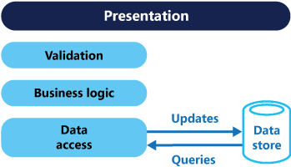
2. Client – Server Architecture for Clinical Decision Support System (CDSS): (Continue.. 4)
Server: Repository Layer
CQRS Architectural Pattern: This architecture also followed CQRS architectural pattern. CQRS stands for Command and Query Responsibility Segregation, a pattern that separates read and update operations for a data store. Implementing CQRS in your application can maximize its performance, scalability, and security. The flexibility created by migrating to CQRS allows a system to better evolve over time and prevents update commands from causing merge conflicts at the domain level.
Queries: Queries are read only operations to retrieve required data from database to process an operation or to display in user interface.
Commands: Commands are write operations to perform creation, updating and deletion of data from database during execution of tasks in application.

Slide 104
Justification for Client – Server Architecture in Clinical Decision Support System (CDSS) :
Scalability: Client side (user interface) is light weighted and can be easily distributed across various devices. Adding or modifying clients will not much impact on servers and its business logic. We can easily handle load in server side based on user requests.
Flexibility: Updates or changes in user interface can without effecting the server. Similarly updates in server side operations will not impact with clients ensuring seamless maintenance and reducing downtime.
Reusability: We can easily reuse same server operations for different clients with different user interface styles based on client requirements.
User Experience: Client application is very light weight and faster because we are not performing any heavy operations in client side.
Security: Centralized authentication and authorization mechanism allow for controlled access to sensitive patient data, we can adjust security rules and policies based on client’s requirements by handing authentication in client side project.

Slide 105
3. Inventory Management System
Software System:
The Inventory Management System is designed to streamline the tracking, management, and control of an organization's inventory. This system serves as a centralized platform where businesses can effectively monitor their stock levels, manage orders, and optimize supply chain operations. User access controls and seamless integration with other business systems contribute to enhanced data security and a cohesive workflow. This system is pivotal for businesses seeking efficient inventory operations, accurate order fulfillment, and optimized supply chain processes.

Slide 106
3. Multi-Tier Client-Server Architecture for Inventory Management System:
Presentation Tier (Client)
Web Application
Mobile Application
Inventory Management
Order Management
User
Profile
Barcode scanner
Alerts and notifications
Offline
Mode
Application Tier (Server)
Inventory Management Module
Order Management Module
Product Information Processer
Stock
Adjustment
Stock
Transactions
Order Processing
Shipping and Delivery
Return and Refund
Supply Chain Optimization Module
User Access Control Module
Demand Forecasting
Procurement Optimization
Supplier Collaboration
User Authentication & Authorization
User Profile Management
Access Control Logs
Reports and Analytics Module
APIs and Middleware
Data Analysis & Visualization
Performance Metrics Monitoring
Predictive Analytics
API
Endpoints
Middleware Services
External Integration Management
Database (Relational and Non-Relational)

Slide 107
3. Multi-Tier Client-Server Architecture for Inventory Management:
Client: (Web Application)
Inventory Management Module:
Allows users to view and manage product details, including descriptions and images.
Supports actions like adding new products, adjusting stock levels, and removing products.
2. Order Management Module:
Enables users to place new orders, view order history, and track order status.
Integrates with the Inventory Management Module to check product availability.
3. User Profile Module:
Allows users to update personal information, change passwords, and manage notification preferences.
Displays user-specific settings and configurations.

Slide 108
3. Multi-Tier Client-Server Architecture for Inventory Management: (Continue.. 1)
Client: (Mobile Application)
Barcode Scanning Module:
Allows users to scan product barcodes for quick data entry.
Integrates with the Inventory Management Module for efficient stock updates.
Alerts and Notifications:
Sends push notifications for critical alerts, low stock levels, or order status updates.
Keeps users informed in real-time.
Offline Mode:
Enables users to perform essential tasks even when offline.
Syncs data with the server when the device is back online.

Slide 109
3. Multi-Tier Client-Server Architecture for Inventory Management: (Continue.. 2)
Server:
Inventory Management Module:
Product Information Processing:
Manages product details, including SKU, description, pricing, and supplier information.
Tracks stock levels and triggers alerts for low stock.
Stock Adjustment:
Processes stock adjustments, additions, and removals.
3. Stock Transactions:
Records transactions for stock movements.

Slide 110
3. Multi-Tier Client-Server Architecture for Inventory Management: (Continue.. 3)
Server:
Order Management Module:
Order Processing:
Manages customer orders, including order creation, modification, and cancellation.
Verifies product availability and updates stock levels upon order fulfillment.
Shipping and Delivery Management:
Integrates with shipping carriers for real-time tracking.
Manages order delivery schedules and updates order statuses accordingly.
Return and Refund Handling:
Manages the process of product returns and facilitates refunds or replacements.

Slide 111
3. Multi-Tier Client-Server Architecture for Inventory Management: (Continue.. 4)
Server:
Supply Chain Optimization Module:
Demand Forecasting:
Analyzes historical data to predict future product demand, aiding in inventory planning and procurement.
Procurement Optimization:
Recommends optimal procurement quantities based on demand forecasts and inventory levels, ensuring efficient stock management.
Supplier Collaboration:
Facilitates communication and collaboration with suppliers for seamless order fulfillment and procurement.

Slide 112
3. Multi-Tier Client-Server Architecture for Inventory Management: (Continue.. 5)
Server:
User Access Control Module:
User Authentication and Authorization:
Manages user access through secure authentication and role-based authorization.
User Profile Management:
Enables users to manage their profiles and customize system settings.
Access Control Logs:
Logs user access and system modifications for auditing and compliance.

Slide 113
3. Multi-Tier Client-Server Architecture for Inventory Management: (Continue.. 6)
Server:
Reports and Analytics Module:
Data Analysis and Visualization:
Provides tools for in-depth data analysis and visualization, enabling users to gain insights into inventory trends, order patterns, and overall system performance.
Performance Metrics Monitoring:
Monitors system performance metrics, ensuring optimal response times and resource utilization.
Predictive Analytics:
Utilizes machine learning algorithms for predictive analytics, assisting in forecasting inventory needs and identifying potential issues.

Slide 114
3. Multi-Tier Client-Server Architecture for Inventory Management: (Continue.. 7)
Server:
APIs and Middleware:
API Endpoints:
Defines and manages RESTful APIs for seamless communication between the client-side applications and server-side components.
Middleware Services:
Manages asynchronous tasks, real-time updates, and event handling to enhance communication efficiency between client and server.
External Integrations Management:
Facilitates integrations with external systems, such as Customer relationship management (CRM) and enterprise resource planning (ERP), ensuring seamless data exchange.

Slide 115
4. IPermit System
An iPermit System is an online platform designed to streamline and manage the process of obtaining permits. The iPermit System revolutionizes permit processes, offering a seamless digital experience for applicants and authorities. Users submit applications, upload documents, and receive automated updates, ensuring efficiency and transparency. The system streamlines approvals, facilitates secure online payments, and maintains a comprehensive digital record for monitoring and reporting, making it indispensable for permit management. The system is typically used in various contexts, such as by local authorities, educational institutions, or organizations that require a structured and efficient way to handle permit requests.

Slide 116
4. MVC Architecture for IPermit System:
Controller (C)
Application Controller
Notification Controller
Submit Applications
Upload Documents
Payment Controller
Receive Automated Updates
Authentication Controller
View (V)
Model (M)
Applicant Dashboard
Authority Dashboard
Permit Application Model
User Model
Payment Interface
Notification Panel
Payment Model
Notification Model
User/Applicant
Database

Slide 117
4. MVC Architecture for IPermit System:
View: (User Interface)
Applicant Dashboard: Provides UI for users to submit permit application form, upload their necessary documents via file upload option and to display the status of their application from and updates.
Authority Dashboard: Local authorities or employees in an institutions can review customer applications and have an option to either approve or reject an applications.
Payment Dashboard: Display the payment options for applicants and provides payment confirmation and receipt details.
Notification Panel: It displays automated updates, communication history, alerts to users and authorities about status of their applications.

Slide 118
4. MVC Architecture for IPermit System: (Continue..1)
Controller: (Application Logic)
Application Controller: Manage the complete flow of permit application process. It validate and process user input for application submission and handles uploaded documents.
Notification Controller: It Orchestrates the generation and sending of automated updates and notifications. It also co-ordinates with the notification model to maintain communication history.
Payment Controller: Co-ordinates with the payment models for processing online payments ensures security and integrity of payment transactions.
Authentication Controller: Handles user registration, login and forget password operations and manages user sessions and authorization levels.

Slide 119
4. MVC Architecture for IPermit System:
Model: (Permit Data and Interaction with database)
Permit Application Model: Responsible for handing permit application information to communicates with database to store and retrieve, update and delete the permit application records.
User Models: Manages user data, user application information and authorities details. This models also handles user authentication and authorization data transfers.
Payment Models: Manages Payment related information and integrates with payment gateway form different providers to like google pay, Paytm for processing online payments.
Notification Models: Handles the generation and sending of automated updates and notifications. It also keep track of communication history between the system and users.

Slide 120
Justification for MVC in Ipermit:
Component Isolation: Permit data management and business logic (Model) are handled independently from user interfaces (View) and application logic (Controller). This separation makes the system modular, easier to understand, and maintain.
Scalability and Reusability: As the IPermit System evolves, developers can scale or modify the Model, View, or Controller without affecting the other components. This makes it easier to adapt to changing permit requirements or user interface enhancements.
Maintainability and Testability: Maintenance becomes more straightforward since modifications to the permit data logic (Model) or user interface (View) won't impact the entire system. Additionally, testing becomes more efficient as individual components can be tested in isolation.
User Interface Flexibility: The IPermit System can have various interfaces (web, mobile) presenting permit information in a way that suits each platform. The View component can be adapted or extended without affecting the underlying permit data management (Model) or application logic (Controller).
Improved Collaboration: Developers working on permit data logic can collaborate independently of those working on user interfaces or application logic. This division of labour enhances productivity and allows for parallel development.

Slide 121
5. Ticketing System
A Ticketing System is a digital platform designed to efficiently manage and streamline the process of handling service requests, support issues, or inquiries. It serves as a centralized hub where users can submit, track, and resolve various types of tickets or requests. The system is commonly used in customer support, IT help desks, and environments to ensure a structured and organized approach to handling user queries.
Service Oriented Architecture Explanation:
Services (Functional Components): The Ticketing System is broken down into independent services, each responsible for a specific function. For example, one service might handle ticket creation, another manages status updates, and so on. This modular approach allows for flexibility and scalability.
Service Registry (Directory of Services): The Service Registry acts as a centralized directory that keeps track of all available services within the system. It helps components discover and communicate with each other efficiently. A master list that tells the system which services are available and what tasks they can perform.
Service Consumer (User Interface): Users interact with the Ticketing System through a user-friendly app or website. This component, known as the Service Consumer, connects with the relevant services to create tickets, check status, and manage support requests.

Slide 122
5. SOA Architecture for Ticketing System:
Customer Portal
Support Request
Service Customer (User Interface)
Create New Ticket
Check Status
Create Support Request
Assign To Live Support
Manager Console
Alerts and Notifications
Knowledge Base
Feed Back Options
Monitor Support
Analyse Support Metrics
Offline Access
Agent Dashboard
Service Registry (Directory of Services)
Ticket Service
Status and Query Service
Notification Service
User Management Service
Ticket Creation
Update & Get Ticket Status
Send notifications
Create User
Ticket Validation
Resolve Tickets
Subscribe To Ticket Updates
Update User Profile
Chatbot (AI)
Escalate Ticket
Failure Ticket Tracking
User Activity Logs
Live chat with Agent
History & Search Tickets
Security Alert System
Deactivate User
Ticket Database
Notifications DB
Users Database

Slide 123

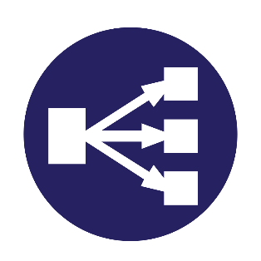

Architecture MVC distributed deployment
Example
Virtual Network <->
← Public Subnet
Private Subnet →
End Users
Kubernetes
Virtual Machine (Public IP)
Virtual Machine (Private IP)
Windows OS
Linux OS
Docker 1
Docker 2
Frontend Project (View)
Backend Project (Controllers and Models)
Fig: Combination of monolithic and Distributed Architecture.

Slide 124
Explanation of MVC Distributed deployment:
By this architecture, we retrieved the advantage of monolithic architecture which in terms of simple design, easy maintenance, low network latency and easy deployment. Along with this, we also achieved microservice architecture advantages like scalability with internal Load balancer which is configured in Kubernetes.
By this architecture we can serve our application in cross platforms or single operating system with different versions which will helps when our different packages or frameworks in our application need to compatible with different OS or OS Versions.
Segregation of API from UI with Private IP will give more security to our database. SQL server only interacts with API private IP which cannot be directly accessible with browser.

Slide 125
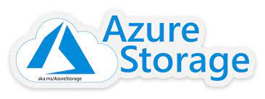

Architecture 2 (Enhanced): Hybrid of 3tier and SOA
Example
Virtual Network <->
Virtual Machine (Public IP)
Virtual Machine (Private IP)
End Users
Web app (Frontend)
Dotnet App (Backend)
Kubernetes Cluster
Docker 1
Pod 1
Pod n
Docker 3
View
File Service (M-C)
File Service (M-C)
Application Gateway
Pod 1
Pod n
Docker 4
Mobile app (Frontend)
Home Service (M-C)
Home Service (M-C)
Load Balancer
Docker 2
View
Pod 1
Pod n
Docker k
Kth Service (M-C)
Kth Service (M-C)
This architecture is a combination of monolithic UI and distributed API (SOA) based API projects achieved by microservices. By this architecture, we achieved all of advantages of multi architecture discussed in above example along with code or service reusability and less resource utilization.

